Slide 1
Optimizing FPGA-based Accelerator Design for Deep Convolutional Neural Networks
https://dl.acm.org/doi/10.1145/2684746.2689060

Slide 2
CNN on FPGAs
CNN has been proposed based on FPGA platform
High performance
Reconfigurability
Fast development round
Capability of reconfiguration
Problem
Computation throughput may not match well the memory bandwidth provided on FPGA platform
Underutilization of either logic resource or memory bandwidth
For solution of CNN design quantitively analyze its computing throughput and required memory bandwidth using various optimization techniques, such as loop tiling and transformation
With help of roofline model identify the solution with best performance and lowest FPGA resource requirement
As case study they implement CNN accelerator on VC707 FPGA. Achieves peak performance of 61.62 GFLOPS under 100 MHz working frequency (floating point operations per second is a measure of computer performance)

Slide 3
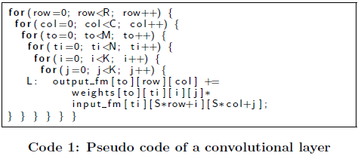
CNNs
CNN employs a feedforward process for recognition and a backward path for training.
Train off-line and use for recognition
Feature extractor and classifier, classifier decides the category of image
C-S+K
C
K
R-S+K
R
K
N
N
M
M
Input feature maps
Weights
Output feature maps

Slide 4
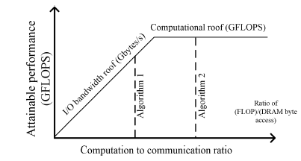

Roofline Model
Roofline model is to relate system performance to off-chip memory traffic and the peak performance provided by the hardware platform
FLOPS : floating point operations per second
Implementation can be either computation bounded, or memory bounded.
CTC ratio is flop/byte (how much work done for every byte), BW is Gbytes/s
Actual floating-point performance can be no higher than min of:
Peak floating-point throughput provided by all the computation resources in the system (computational roof)
Operations per DRAM traffic, or computation to communication ratio, features the DRAM traffic needed by a kernel in specific implementation.

Slide 5
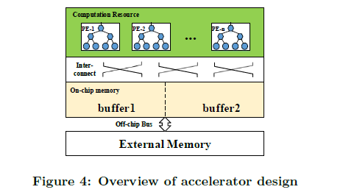
Design Overview
On-chip buffer : Data are first cached in on-chip buffers before being fed to PEs. Double buffers used to cover computation time with data transfer time
External memory : All processing data stored here
Processing elements (PEs) : Basic computation unit for convolution (multiplier adder tree)
On-/off-chip interconnect : On-chip interconnect dedicated for data communication between PEs and on-chip buffer banks.
Challenges:
Loop tiling mandatory to fit small portion of data on-chip.
Organization of PEs and buffer banks and interconnects
Data processing throughput of PEs should match off-chip bandwidth of FPGA platform

Slide 6
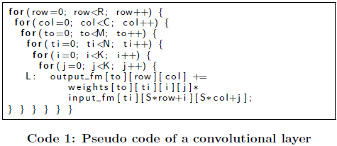
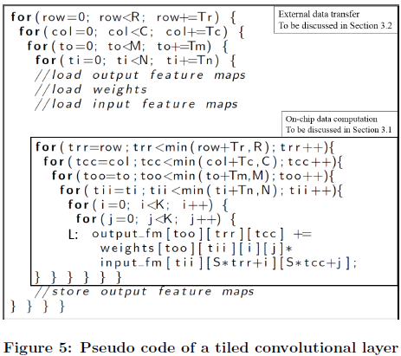
Loop Tiling
Loop iterators (row, col, to and ti) are tiled into tile loops and point loops (trr, tcc, too and tii in Figure 5).
Bring one tile on-chip, process that and move to next chip. It reduces on chip memory requirement
Loop 1 and 2 moves over Tr and Tc over output feature map and loop 5 and 6 moves through individual values in those tiles
Loop tiling over M and N allows us to parallelize
Operate on Tm output channels and Tn input channels
Tiling tradeoff b/w data transfer and on chip memory
Tm
Tr
Tc
R
C

Slide 7
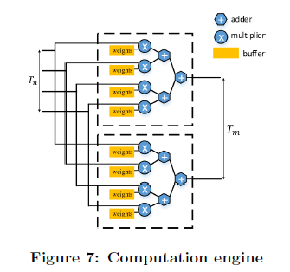
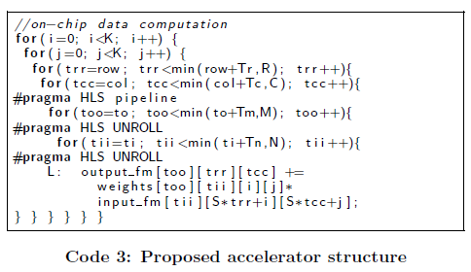
Loop unrolling
Loop unrolling is a loop transformation technique that helps to optimize the execution time of a program. We basically remove or reduce iterations. Loop unrolling increases the program’s speed by eliminating loop control instruction and loop test instructions.
If we unroll a loop, we implement the loop instructions as parallel hardware. Here it increases the number of multipliers and adders as a multiplier adder tree.
We have Tm accumulators each multiplying Tn words
Tm – how many vector dot product units we have
Tn – vector dot product units becomes more parallel

Slide 8
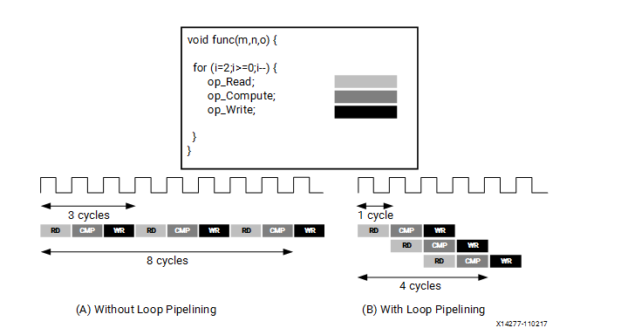
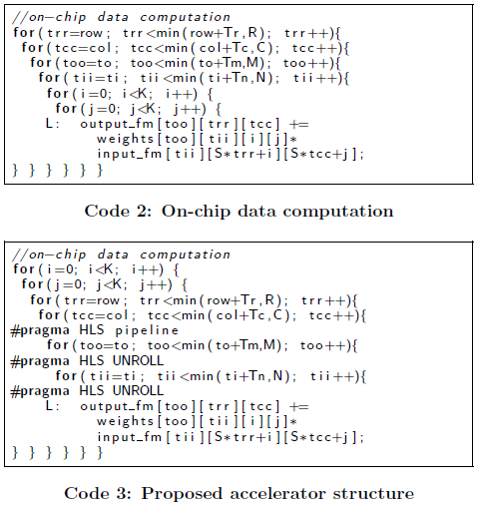
Loop pipelining
Pipelining a loop allows the operations of the loop to be implemented in a concurrent manner.
Overlapping the execution of operations from different loop iterations

Slide 9
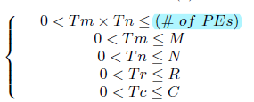
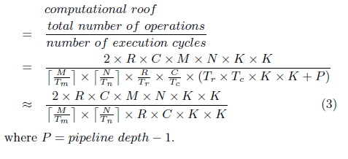
Tile size selection
Legal tile sizes
Given a specific tile size combination <Tm; Tn; Tr; Tc>, the computational performance (or computational roof in the roofline model) can be calculated by Equation (3). From the equation, we can observe that the computational roof is a function of Tm and Tn.

Slide 10
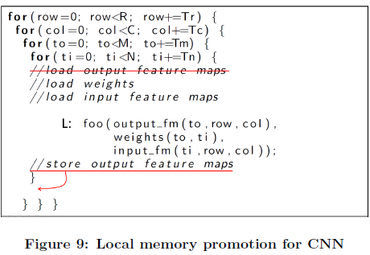
Local memory promotion
Reduce communication volume
Input/output feature maps and weights are loaded before the computation engine starts and the generated output feature maps are written back to main memory.
In Figure 9, the innermost loop dimension ti is irrelevant to array output fm. Thus, the accesses to array output fm can be promoted to outer loops.

Slide 11
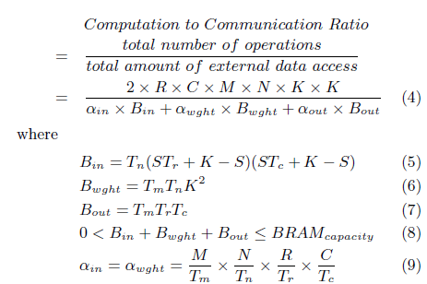

CTC ratio
Computation to communication (CTC) ratio is used to describe the computation operations per memory access.
The computation to communication ratio of the code shown in Figure 9 can be calculated by Equation (4)
As we parallelize, we have to duplicate buffers.

Slide 12
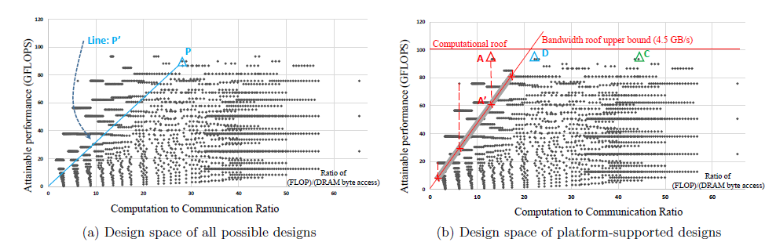
Design Space exploration
Given specific loop schedule and size tuple <Tm, Tn, Tr, Tc> computational roof and CTC ratio is calculated
In (b) the line of bandwidth roof and computational roof are defined by the platform specification.
We pick the one with the highest CI value because this design requires the least bandwidth.

Slide 13
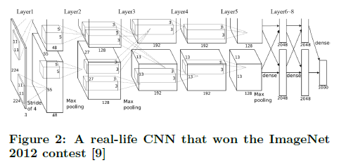
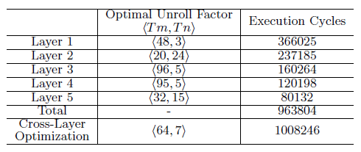
Multi layer accelerator design
Designing a hardware accelerator to support multiple convolutional layer with different unroll factors would be challenging.
Approach is to design a hardware architecture with uniform unroll factors across different convolutional layers.
CNN accelerator with unified unroll factors is simple to design and implement but may be sub-optimal for some layers. Table 4 shows that with unified unroll factors <64,7>

Slide 14
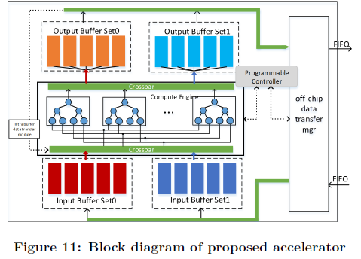
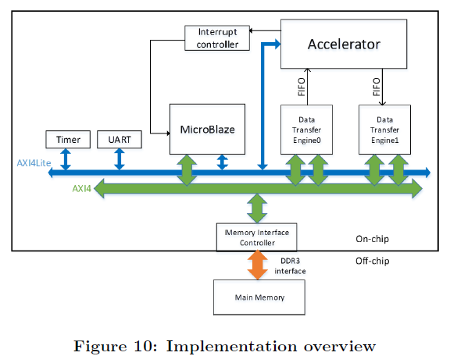
Implementation
DDR3 DRAM for external storage, MicroBlaze, a RISC soft processor core developed for Xilinx FPGAs used to assist with CNN accelerator startup, communication with host CPU and time measurement etc
AXI4lite bus for command transfer and AXI4 bus for data transfer
Data transfer engine can access external memory through AXI4 bus
On-chip buffers are built upon a basic idea of double-buffering. Double buffers are operated in a ping-pong manner to overlap data transfer time with computation.

Slide 15
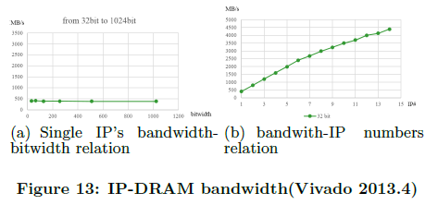
External Data transfer engines
Set two parameters (1) bitwidth of AXI bus to DRAM controller (2) DRAM controller external bandwidth at their highest configurations while changing number of IP-AXI interfaces and the bitwidth of each IP
Increase in IP-AXI interface bitwidth has no effeect on bandwidth (400MB/s under 400MHz)
With more IP interfaces added to AXI bus, its bandwidth increases almost linearly
Require 1.55 GB/s. 4 IP interfaces are sufficient for this design. Two interfaces in data transfer engine0 and two in data transfer engine 1.

